Slide 1
School of Computer Science & Engineering
AI Application Development – IA2
AI-Powered Discussion Monitor and Action Item Tracker

Slide 2
Team Members & Roles
Team member name | Role
Markandeshwaragouda Patil | Team Lead
Manasa K M | Customer Contact Lead
Pranathi R N | Test Lead
Pavan H K | Developer
Navaneeth S | Development Lead
Rohith L, Nikhil M | DevOps / GitHub / Product Build / Documents
Notes:
Talk about how they are managing their documents, how google docs does automatic versioning
As them what they know about Android and IoS versions

Slide 3
AI-Powered Discussion Monitor and Action Item Tracker
As virtual meetings and online collaboration environments become increasingly prevalent, maintaining structured, respectful, and outcome-oriented discussions has become a significant challenge.
Important action items and decisions are missed or not tracked properly .
Existing tools (Zoom, Teams, Meet) do not provide real-time intelligent monitoring or automation.
Notes:
Talk about how they are managing their documents, how google docs does automatic versioning
As them what they know about Android and IoS versions

Slide 4
Problem Statement
In today’s virtual meetings, discussions often become unstructured and inefficient.
Major Problems:
Meetings go off-topic
Important decisions are missed
Action items are not tracked properly
Manual note-taking is time-consuming
Existing tools like Zoom and Google Meet only record meetings
No real-time intelligent monitoring exists
Need :
An AI-powered system that keeps meetings focused and automatically tracks important outcomes.

Slide 5
Our Solution
SyncMeet AI is a real-time AI-powered meeting assistant that helps improve meeting productivity.
It can:
Monitor discussions
Detect off-topic conversations
Extract action items
Generate meeting summaries
Reduce distractions
Improve accountability
Goal:
To make meetings more structured, productive, and outcome-oriented.

Slide 6
MVP Demo
MVP (Minimum Viable Product)
MVP is the basic working version of a product that solves the core problem using the most important features.
Our Goal:
To prove that SyncMeet AI can reduce manual effort and improve meeting productivity.
Core MVP Features:
Post-Meeting Summary
Action Item Extraction
Topic Alignment Detection
Toxicity Detection
Key Highlights
Manual Trigger System
Meeting Summary Generation

Slide 7
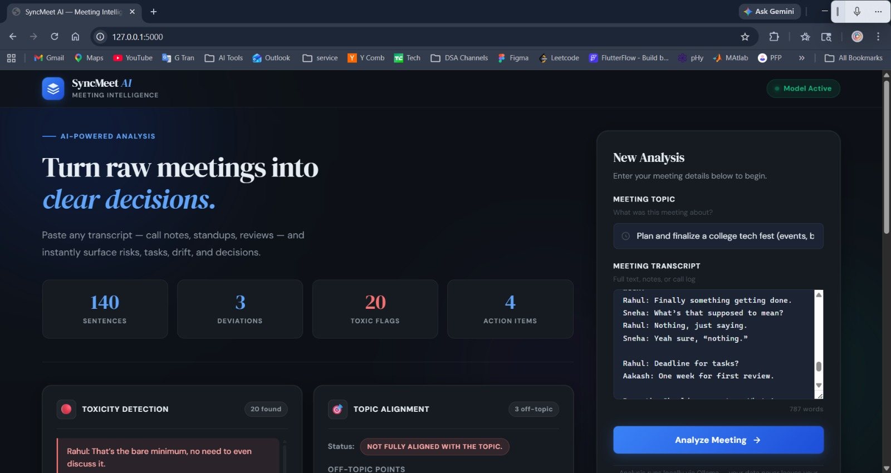
Demo Example 1 AI-Powered Meeting Analysis Dashboard

Slide 8
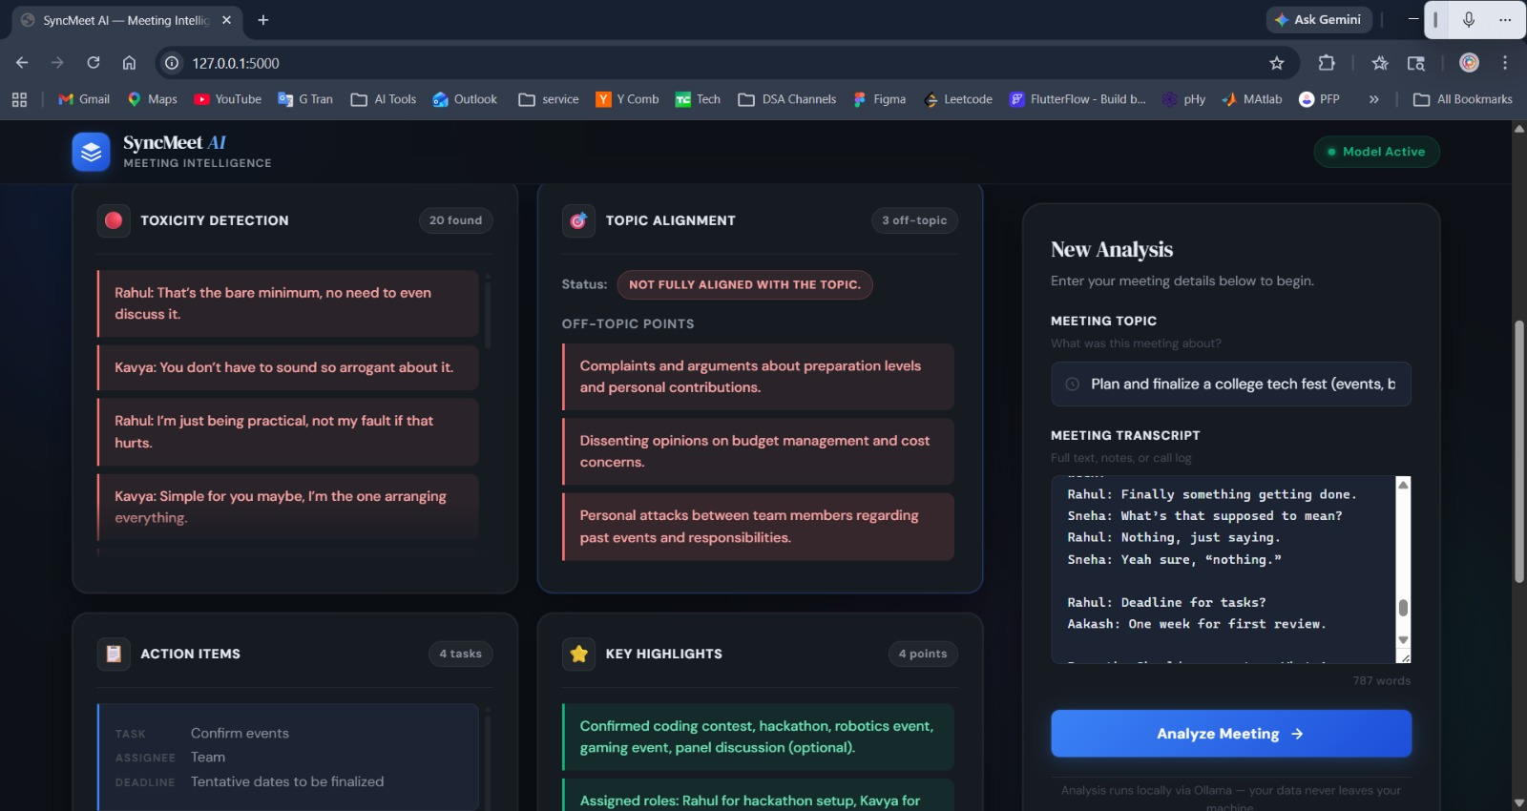
Toxicity & Topic Alignment Detection

Slide 9
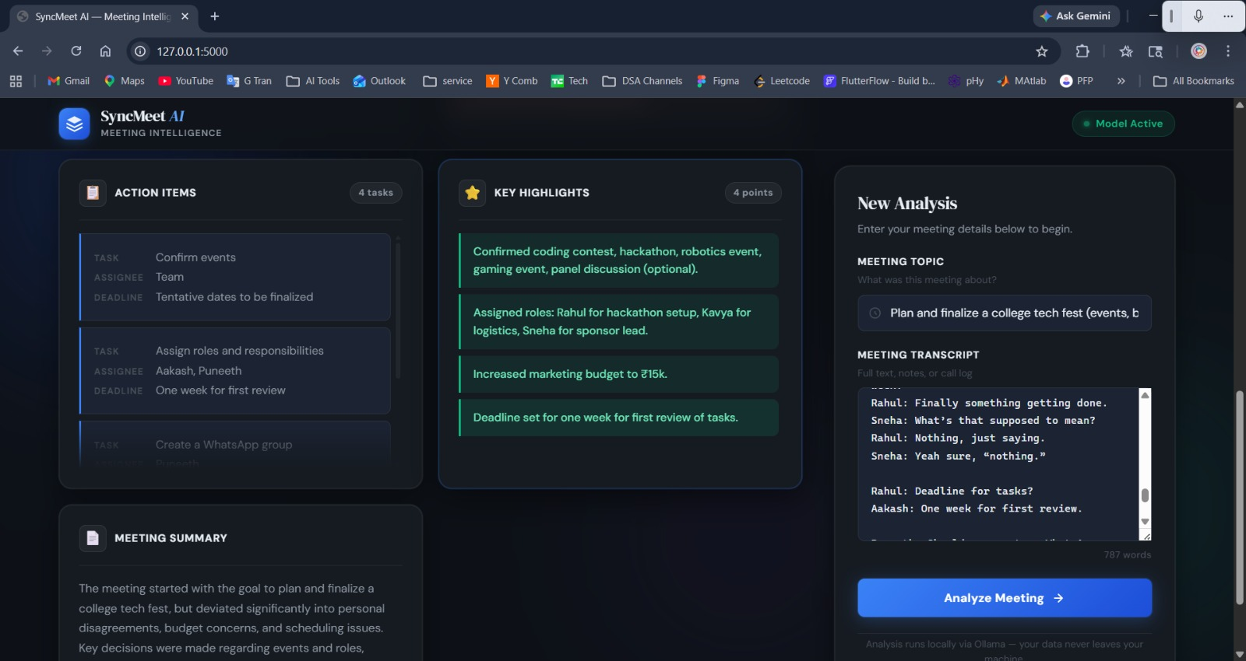
Action Item Extraction and Meeting Summary Generation

Slide 10
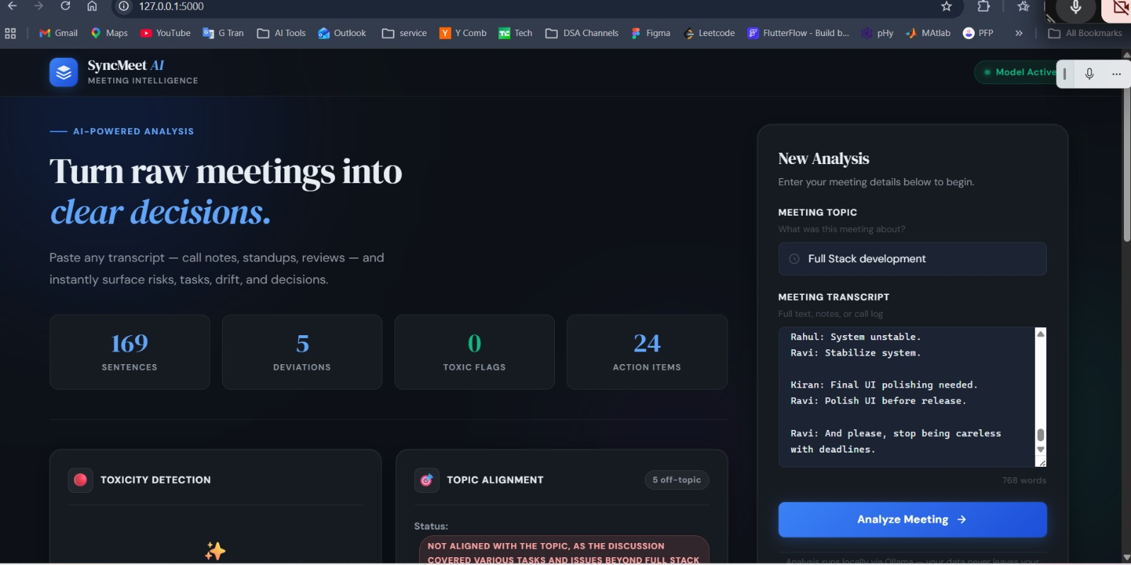
Practical Use Case

Slide 11
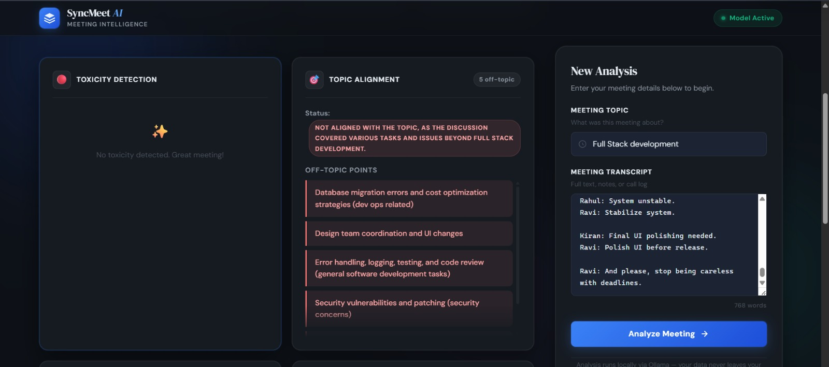
Conflict Detection

Slide 12
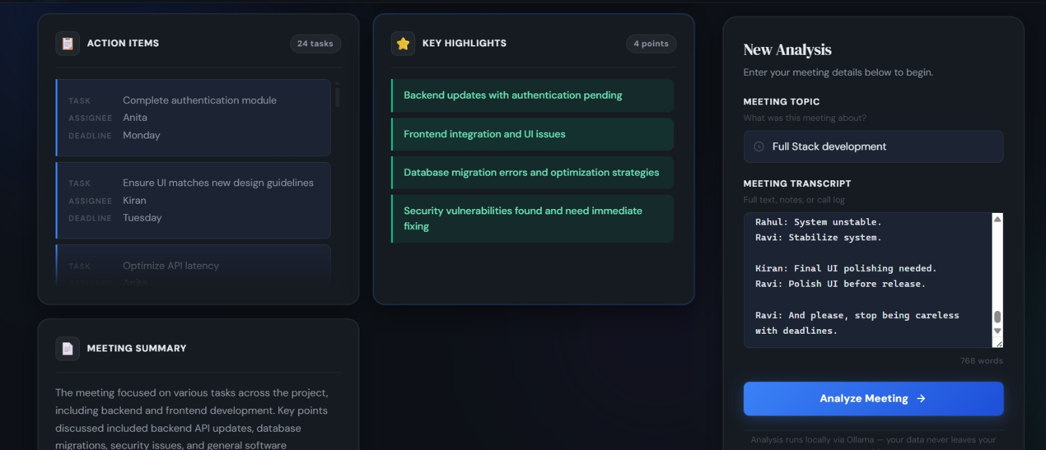
Complete AI Dashboard

Slide 13
User/ Customer Understanding
1.Do meetings often go off-topic?
Yes, discussions frequently deviate from the main agenda
2. Are important decisions or action items missed?
Yes, key points are often forgotten or not properly recorded
3. Do some participants dominate or disrupt discussions?
Yes, it affects balance and reduces meeting effectiveness
4. Is it difficult to track discussions in real-time?
Yes, manual tracking is inefficient and error-prone
5. Do existing tools solve these issues?
No, they lack real-time intelligent monitoring and guidance
6. What kind of solution would you prefer?
An AI system that keeps discussions focused and tracks key points
Notes:
Talk about how they are managing their documents, how google docs does automatic versioning
As them what they know about Android and IoS versions

Slide 14
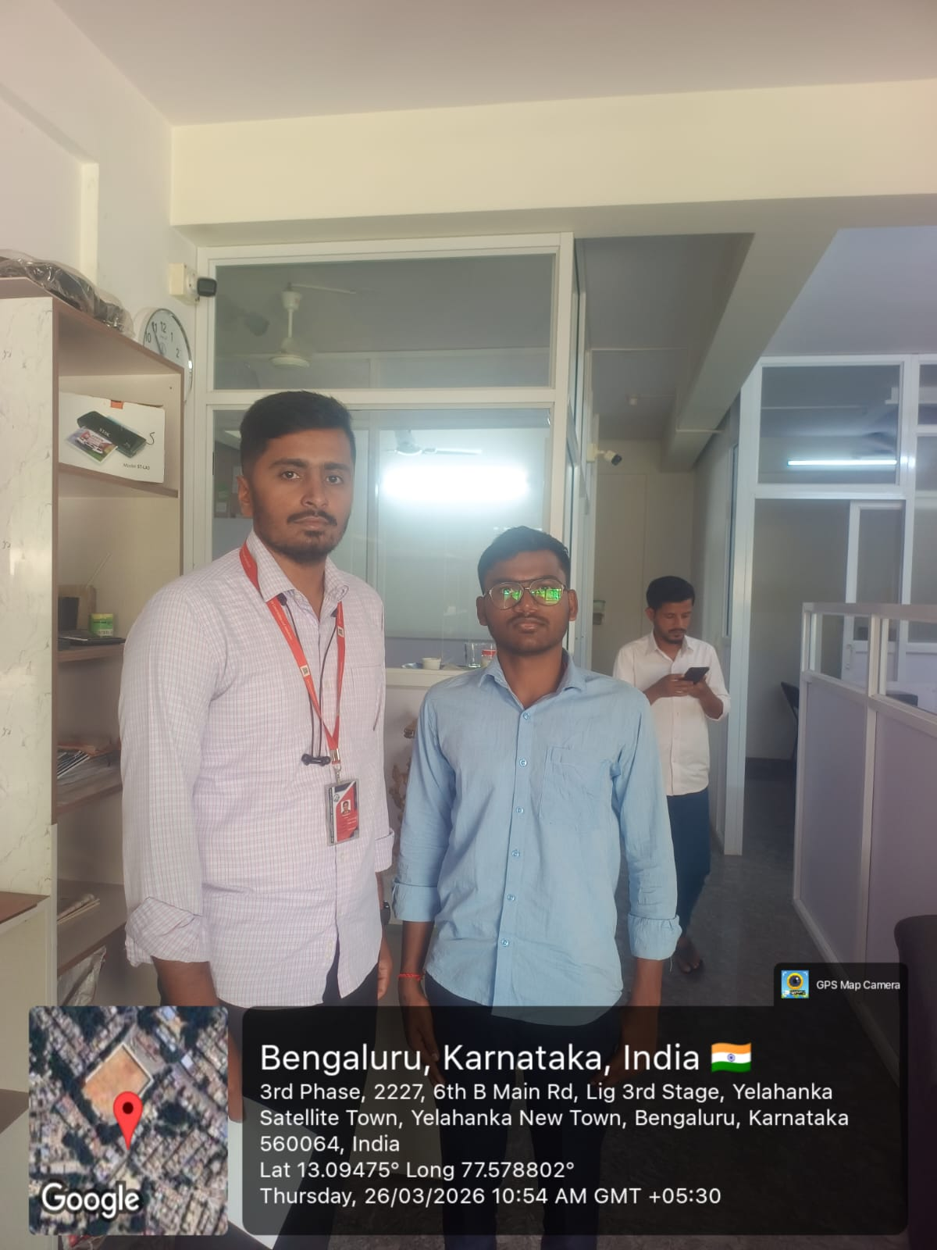
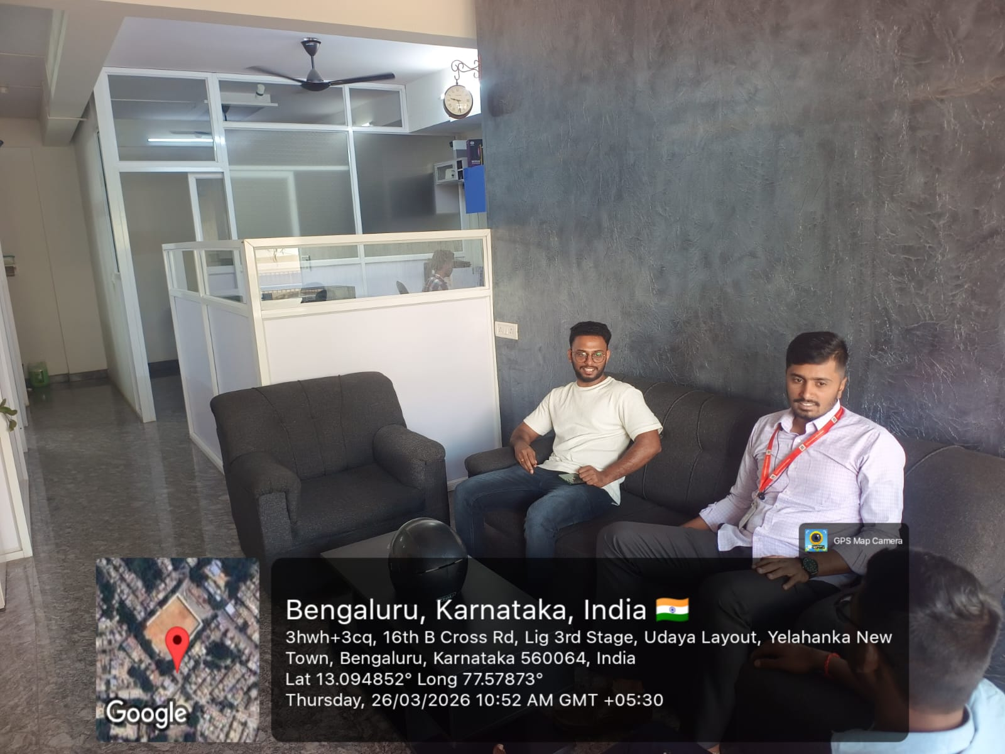
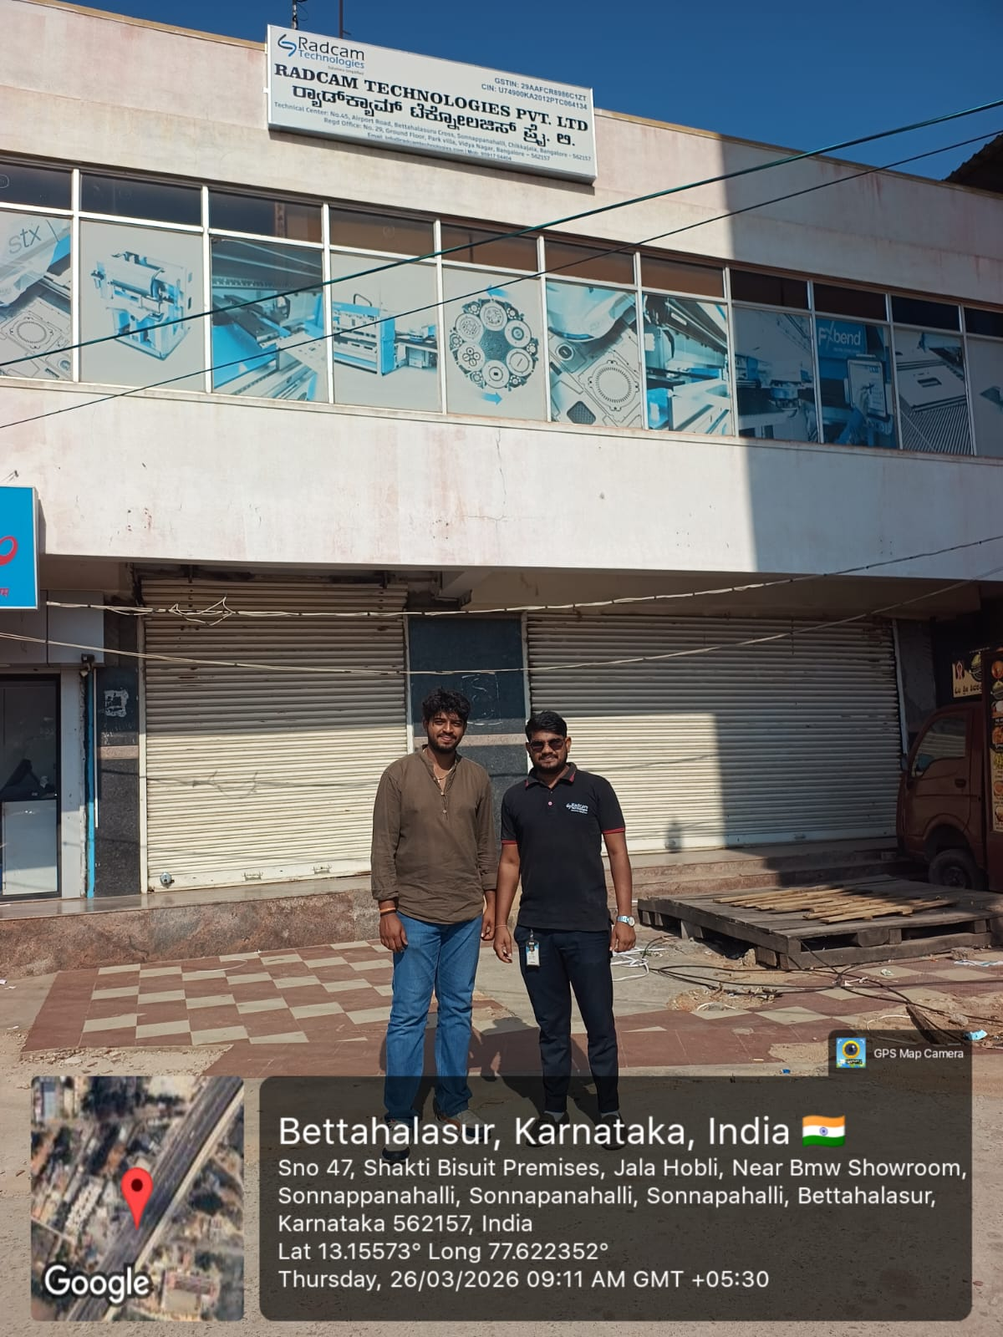
User interviews conducted to validate the problem statement

Slide 15
Pricing Plans Overview
Product Plans
We designed 3 pricing plans for different user needs:
1. Free Plan
2. Pro Plan
3. Pro+ / Focus Plan
This helps attract users and create a sustainable business model.

Slide 16
Free Plan
Hook – “See the Magic”
Goal:Let users experience value quickly
Features:
Post-meeting summary
Action item extraction
3–5 meetings/month
Manual trigger (not fully automatic)
Better Free Tier Version:
Unlimited meetings
Only 8 meetings with AI insights / nudges
Remaining meetings = basic summaries only
This improves customer attraction while controlling costs.

Slide 17
Pro Plan
Core Utility – “Saves Time”
Price: ₹599
Features:
Unlimited meetings
Full AI structured summaries
Full action item tracking
Meeting history (search past meetings)
Basic speaker insights
Export notes (PDF / Docs)
Value:
Improves workflow efficiency and saves time.

Slide 18
Pro+ Plan
Hero Plan – “Maximum Productivity”
Price:₹1499
Features:
Real-time off-topic detection
Live nudges (“Let’s get back to agenda”)
Interruption detection
Distraction alerts
Focus score per meeting
Participant behavior insights
Smart meeting coaching
Hero Feature:
Real-time AI intervention during meetings
This is our strongest value proposition.

Slide 19

Product Promo Video

Slide 20
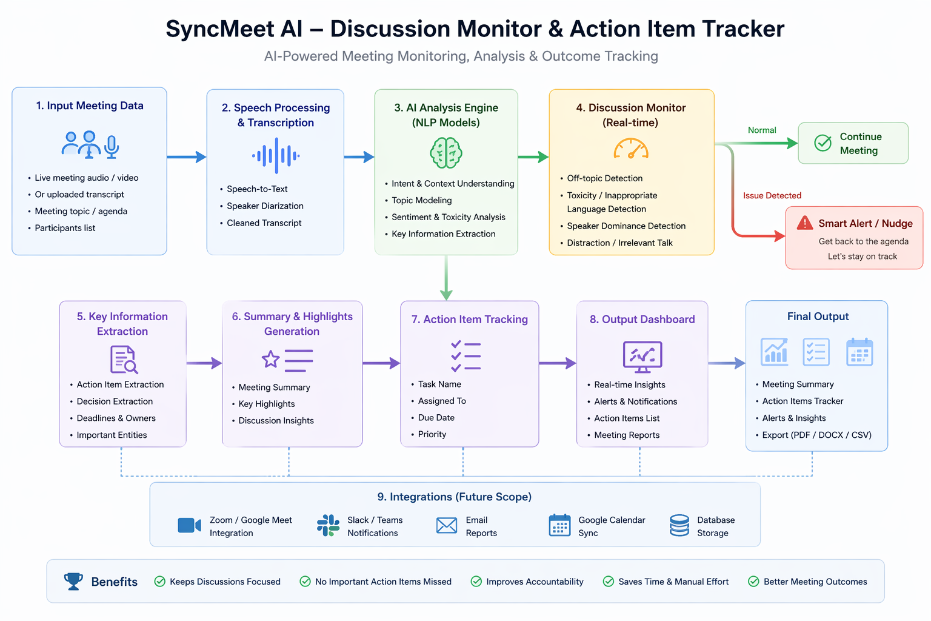
Proof of Concept
Notes:
Only stress on the 1st sentence – the definition
Come back to the 2nd sentence in the end as part of revision

Slide 21
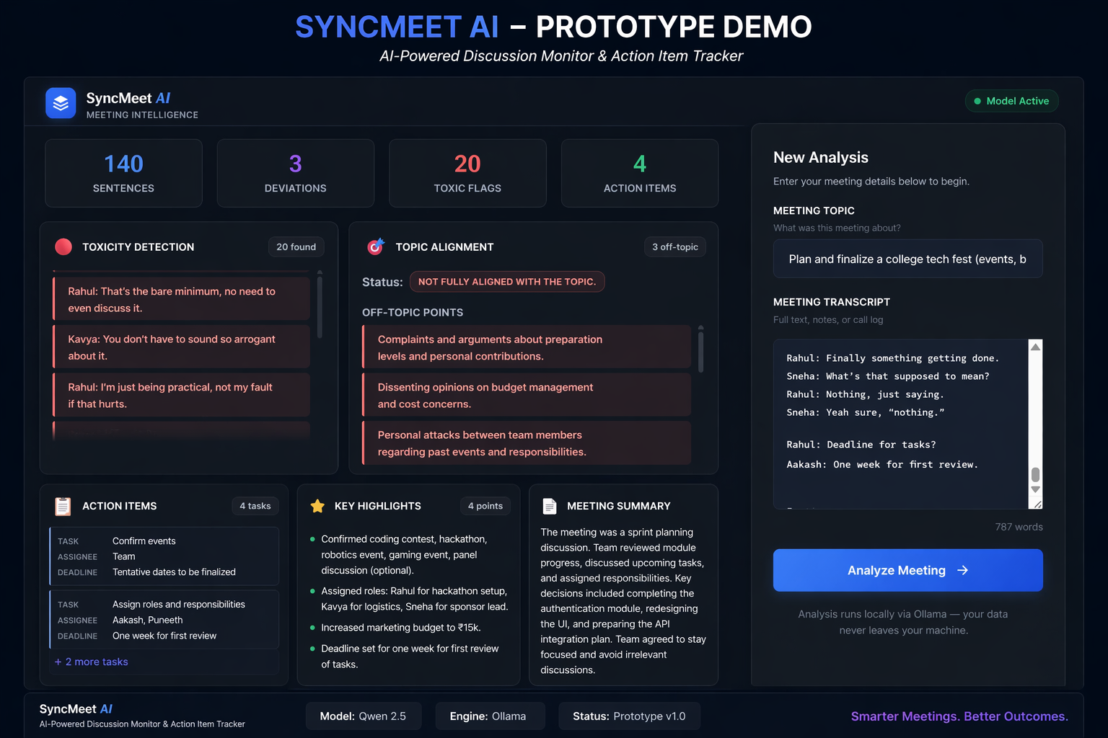
Prototype Demo

